Slide 1



Human Resourses
Data Analysis
Supervised by:
Kareem El-Demerdash
Prepared By:
Analysis Masters Team

Slide 2

Project Name
Bank Customer Churn Analysis
Prepared BY (Analysis Masters Team):
DR. Ahmed Yehya
Doaa Mohamed Salah El-Din Alkhateeb
Supervised By :
Kareem El-Demerdash
Training Company By :
AST Company
Group Code: (Data Analyst Specialist_CAI1_DAT1_G7e)

Slide 3


Introduction
“Hello, my name is Doaa Alkhateeb, and today I’ll be presenting a comprehensive HR dashboard designed to help HR managers make informed, data-driven decisions. This dashboard focuses on three key areas: Overview, Demographics, and Income Analysis, with a detailed employee records view for further exploration.”

Slide 4

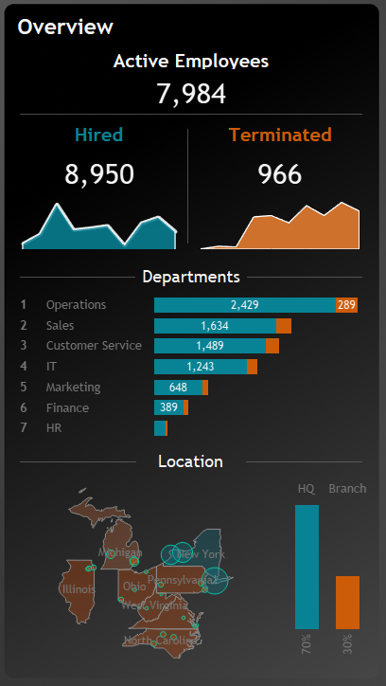
TTotal Employees:
The dashboard reveals the number of currently active employees, employees who have been terminated, and those recently hired. It is clear that hiring has outpaced terminations.
Departmental Breakdown:
The total number of employees by department highlights that which departments have growing in hiring as operation department, sales and customer service respectively
HQ vs. Branch Offices:
A comparison between New York headquarters and other branches in terms of employee count can offer insights into regional growth or challenges in staffing.

Slide 5
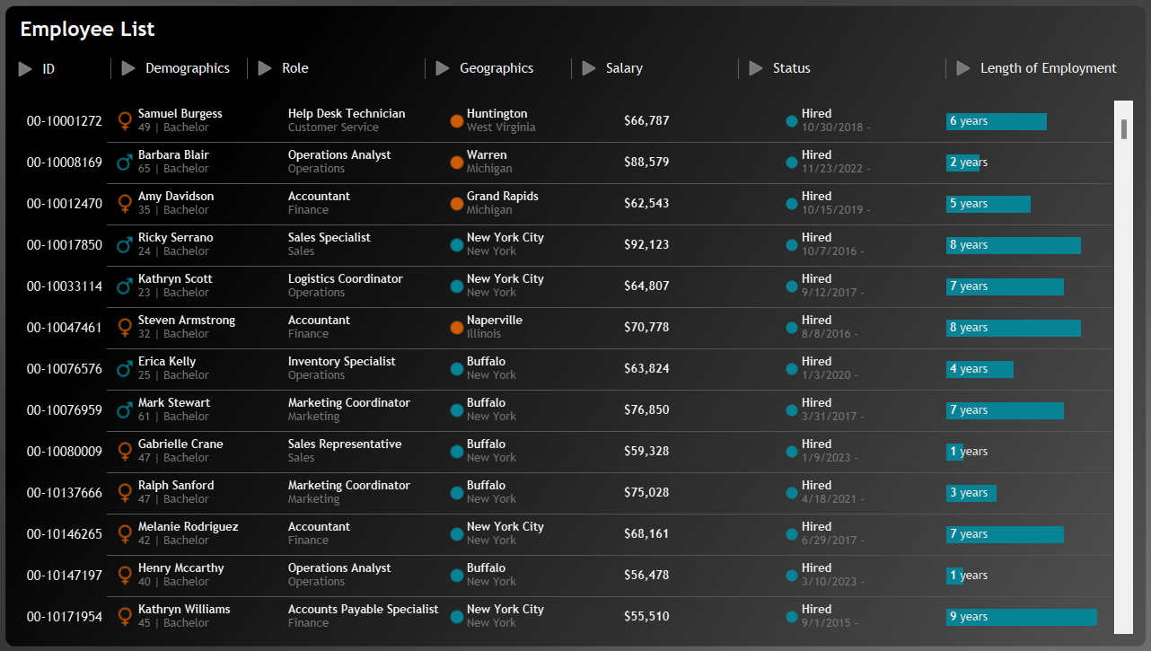
Yearly Trends in Hiring and Termination: By visualizing the hiring and termination trends over several years, HR managers can observe periods of rapid growth or contraction, aligning them with organizational events such as expansion or restructuring.

Slide 6
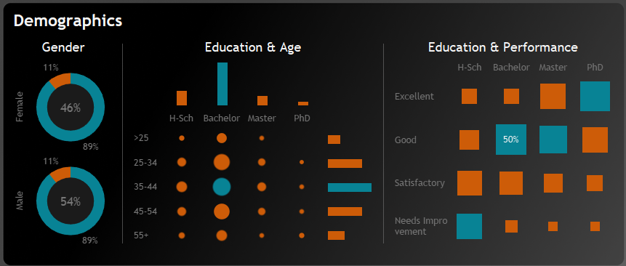
Demographics Section Analysis
Gender Ratio:
The gender distribution allows for analysis of diversity within the workforce, and in these bie charts we can see that no big defferenc in gender distribution.
Age Group & Education Distribution:
This section reveals that age bracket(35-44) dominances the age range and educatinal rank.
Performance vs. Education:
It is obvious that PHD ranks excellent performance, while Bachelore rank needs more support as it deminances educational rank among employees.

Slide 7

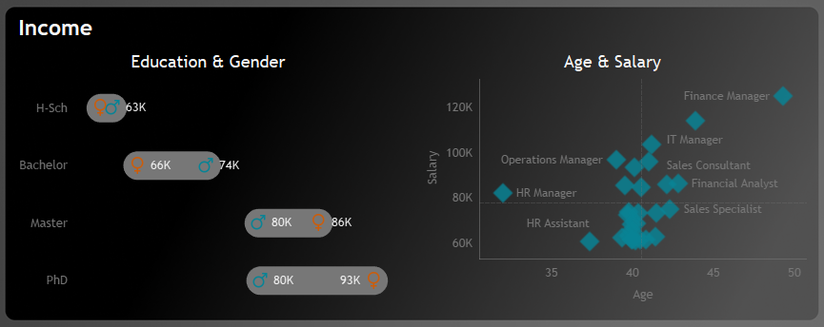
Income Analysis Section
Salary Discrepancy:
Age and Salary Correlation:
The comparison of salaries across education levels for both genders can reveal potential pay gaps. This is crucial for addressing gender equity and ensuring compliance with pay equity laws.
The relationship between age and salary, especially by department, provides insights into career progression and compensation fairness.

Slide 8


Recommendations
Overview Section Analysis:
Optimize resource allocation in marketing and technology departments.
Empower regional offices and consider decentralization strategies.
Support regional expansion with localized investments and workforce development.
Maintain organizational culture across HQ and branches to avoid silos.
Forecast workforce needs and create a strategic, future-oriented hiring plan.
Enhance talent management to improve retention in growing departments.
Demographics Section Insights:
Increase gender diversity in leadership through targeted development and bias-free promotion processes.
Enhance retention of the 25-35 age group by offering career growth, mentoring, and tailored development programs.
Capitalize on high-performing employees with advanced degrees by recruiting more, offering upskilling opportunities, and providing internal mobility.
Establish leadership pipelines for high performers, especially in technical roles, to transition them into leadership.
Offer continuous educational development to employees, encouraging further learning and certifications.
Strengthen DEI efforts at the leadership level through inclusive leadership training, recruitment, and support for employee resource groups.

Slide 9

Recommendations
. Income Section Insights:
Close the gender pay gap at senior management through pay audits, adjustments, and policy changes.
Benchmark salaries for specialized roles to stay competitive and ensure fair pay for younger employees in these roles.
Develop clear compensation frameworks and career progression paths to ensure transparency in how pay increases are achieved.
Ensure pay equity across age groups by adopting skill- and performance-based pay policies.
Conduct regular salary reviews to monitor for and correct pay disparities.
Offer retention bonuses and competitive packages for high-performing employees in specialized, high-demand roles.

Slide 10

THANK YOU

